Slide 1
Competitive Programming
07 Oct. 2022
Andrei Novikov

Slide 2
Revise Homework - Overview
Book: “Competitive Programming 3”. Chapter: 4.2.7 – 4.2.9.
Algorithms:
Bridges and Articulations Algorithm
Tarjan’s Algorithm
Task: UVa 11838 - Come and Go - Link
Solution: Link

Slide 3
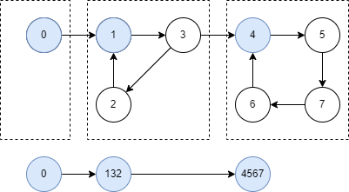
Tarjan’s Algorithm – Problem Statement
Problem Statement – Strongest Connectivity Component

Slide 4
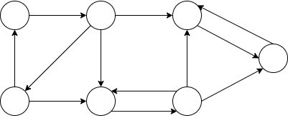
Tarjan’s Algorithm
Initial Directed Graph

Slide 5
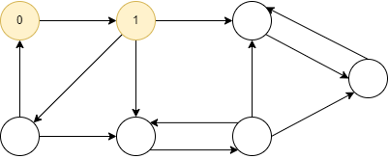
Tarjan’s Algorithm – Apply DFS
Apply DFS to assign IDs

Slide 6
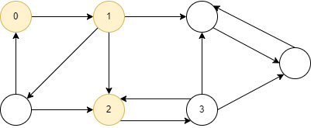
Tarjan’s Algorithm – Apply DFS
Apply DFS to assign IDs

Slide 7
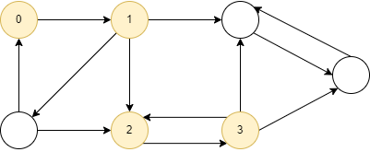
Tarjan’s Algorithm – Apply DFS
Apply DFS to assign IDs

Slide 8
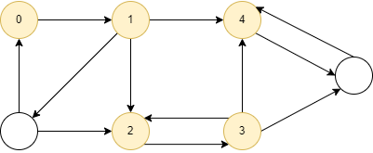
Tarjan’s Algorithm – Apply DFS
Apply DFS to assign IDs

Slide 9
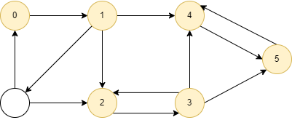
Tarjan’s Algorithm – Apply DFS
Apply DFS to assign IDs

Slide 10
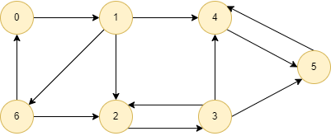
Tarjan’s Algorithm – Apply DFS
Apply DFS to assign IDs

Slide 11
Tarjan’s Algorithm – Apply DFS
Apply DFS to assign IDs

Slide 12
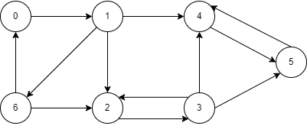
Tarjan’s Algorithm – Assign Low-Link
Assign Low-Links

Slide 13
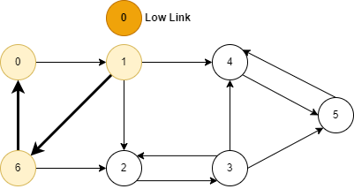
Tarjan’s Algorithm – Assign Low-Link
Assign Low-Links

Slide 14
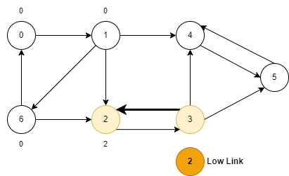
Tarjan’s Algorithm – Assign Low-Link
Assign Low-Links

Slide 15
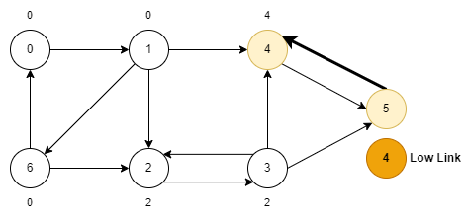
Tarjan’s Algorithm – Assign Low-Link
Assign Low-Links

Slide 16
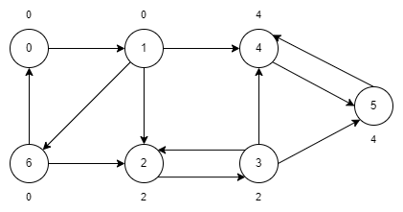
Tarjan’s Algorithm – Assign Low-Link
Assign Low-Links

Slide 17
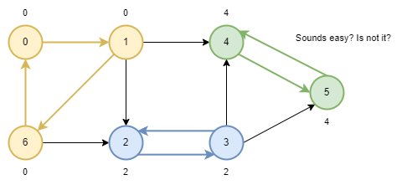
Tarjan’s Algorithm – Done?
Find SCC. Are we done?

Slide 18
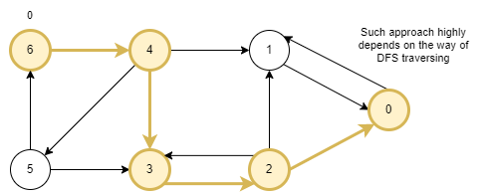
Tarjan’s Algorithm – Done? No!
Low-Link highly depends on DFS order
Pay attention to this counter-example

Slide 19
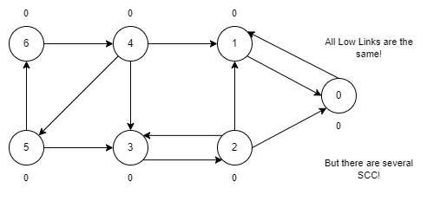
Tarjan’s Algorithm – Done? No!
Low-Links are all the same in this case

Slide 20
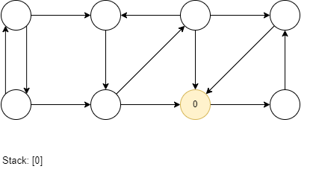
Tarjan’s Algorithm
Apply DFS and store nodes in stack

Slide 21
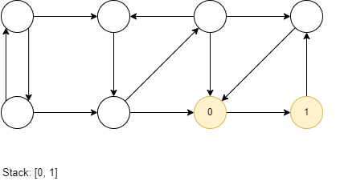
Tarjan’s Algorithm
Apply DFS and store nodes in stack

Slide 22
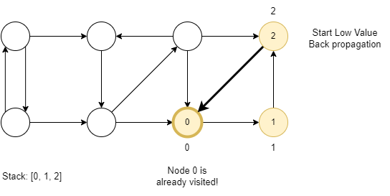
Tarjan’s Algorithm
Apply DFS and store nodes in stack

Slide 23
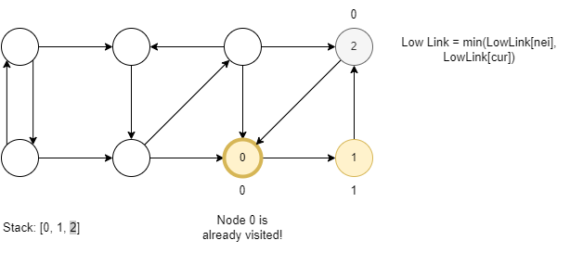
Tarjan’s Algorithm
Returning back and updating Low-Link

Slide 24
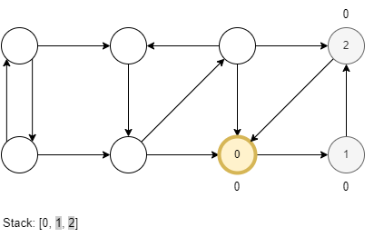
Tarjan’s Algorithm
Updating Low-Link

Slide 25
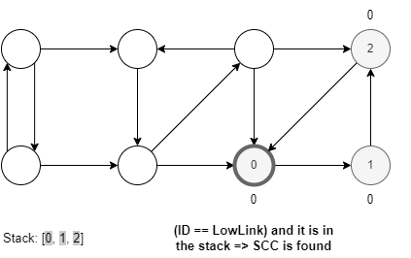
Tarjan’s Algorithm
We reach LowLink node – The first SSC is found

Slide 26
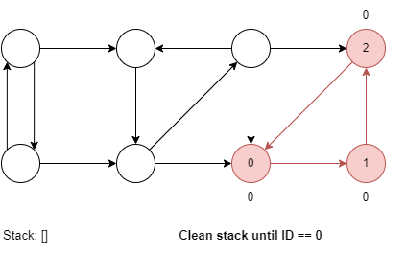
Tarjan’s Algorithm
Clean stack

Slide 27
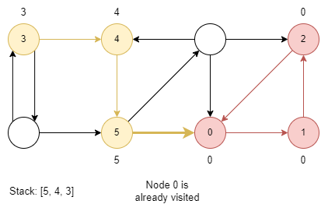
Tarjan’s Algorithm
Get next non-visited node and apply DFS

Slide 28
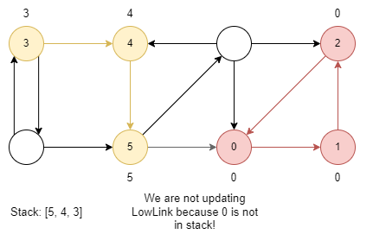
Tarjan’s Algorithm
0 is not in the stack, no need to update LowLink

Slide 29
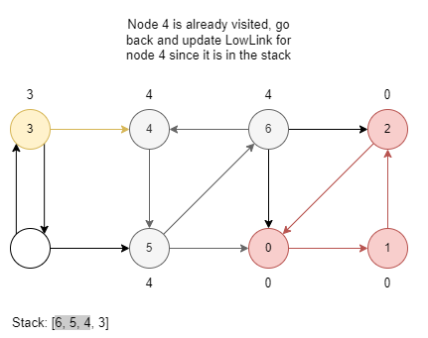
Tarjan’s Algorithm
Returning back and stop when ID == LowLink

Slide 30
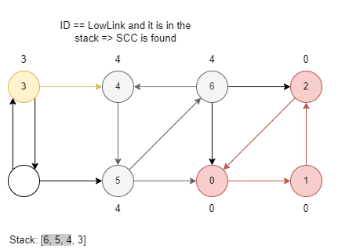
Tarjan’s Algorithm
The second SCC found

Slide 31
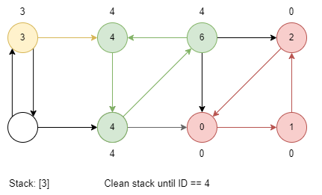
Tarjan’s Algorithm
Continue DFS on 3

Slide 32
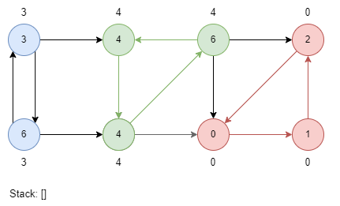
Tarjan’s Algorithm – Done? Yes!
The last SCC is found

Slide 33
Life Practice – Challenge #1
Topic: Graph
Resource: Leetcode 1192 - Critical Connections in a Network

Slide 34
Home task?
Competitive Programming 3. End of the Chapter 4.2:
UVa 00118 – Mutant Flatworld Explorers
UVa 00168 – Theseus and the...
UVa 00280 – Vertex
UVa 00318 – Domino Effect
UVa 00614 – Mapping the Route
The next session: 21 October 2022.

Slide 35




Where to Practice
LeetCode [link]
HackerRank [link]
Kattis [link]
TopCoder [link]
Other Resources

